Slide 1


School of Computing Science and Engineering
INTERACTIVE VOICE RESPONSE SYSTEM WITH SPEECH RECOGNITION
PRESENTED BY :
Rishav Raj - 22SCSE1010527
Priya Tiwari - 22SCSE1010536
Moh. Yusuf Ali - 22SCSE1010545
Vaibhav Singh - 22SCSE1010550
BTECH CSE Semester IV
PROJECT ID : BT2520
Program Name :
B.Tech CSE

Slide 2

School of Computing Science and Engineering
Program Name :
B.Tech CSE

Slide 3
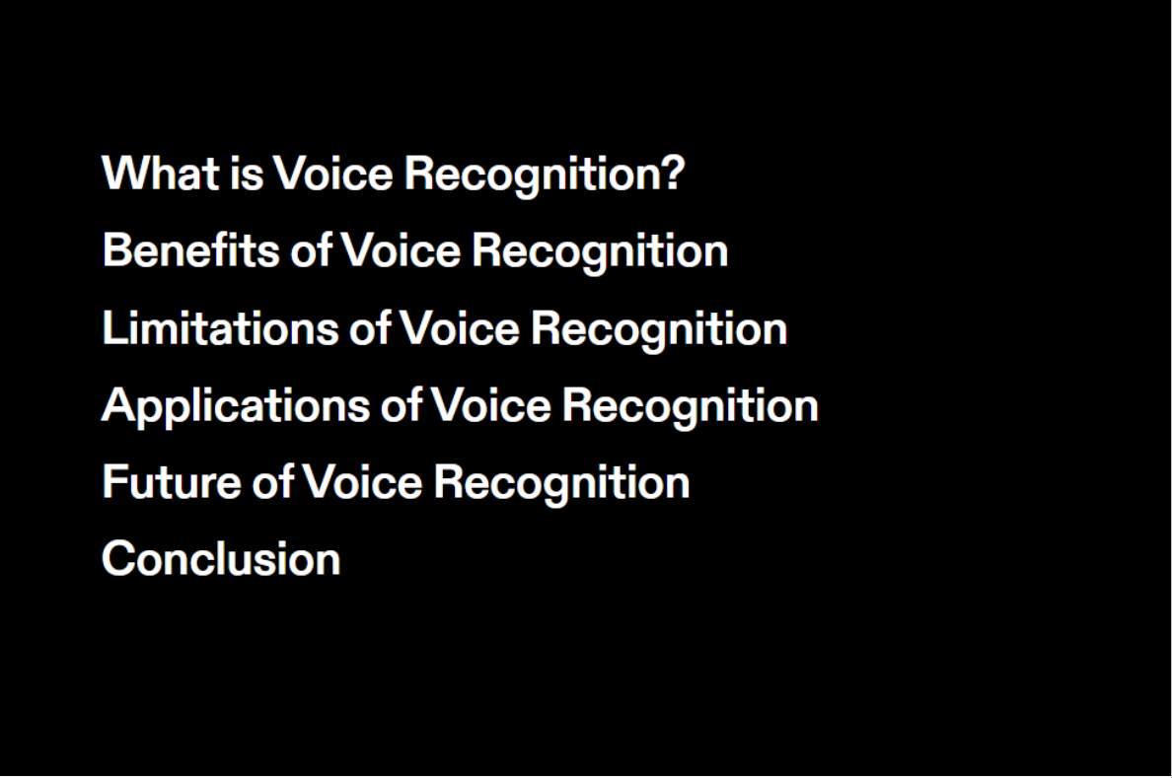
School of Computing Science and Engineering
Program Name :
B.Tech CSE

Slide 4
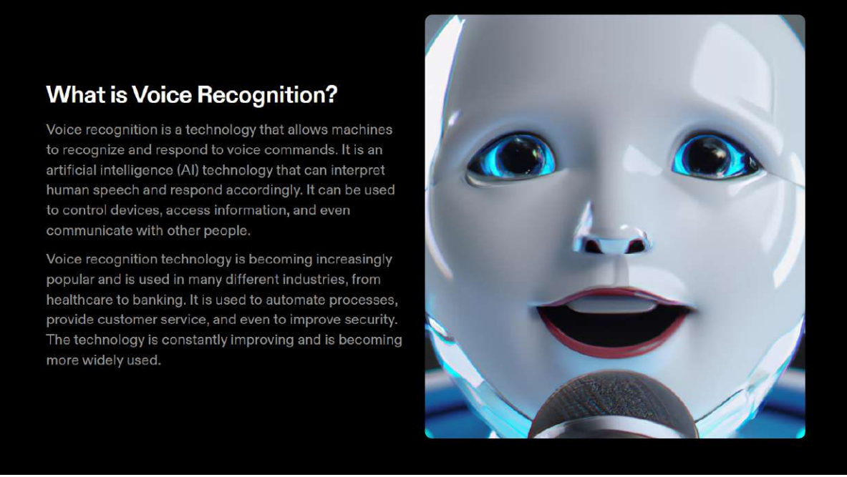
School of Computing Science and Engineering
Program Name :
B.Tech CSE

Slide 5
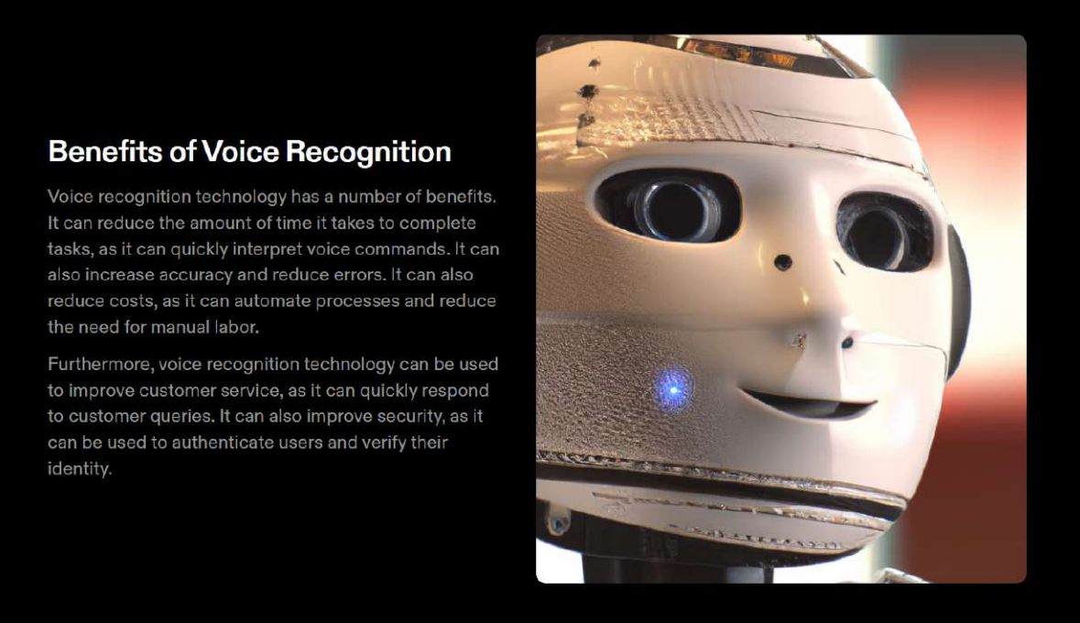
School of Computing Science and Engineering
Program Name :
B.Tech CSE

Slide 6
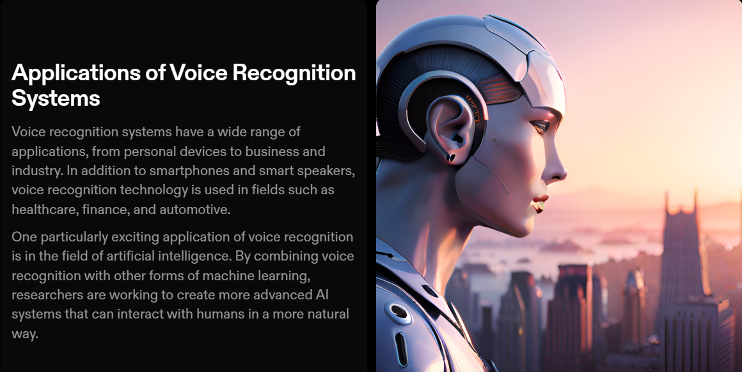
School of Computing Science and Engineering
Program Name :
B.Tech CSE

Slide 7
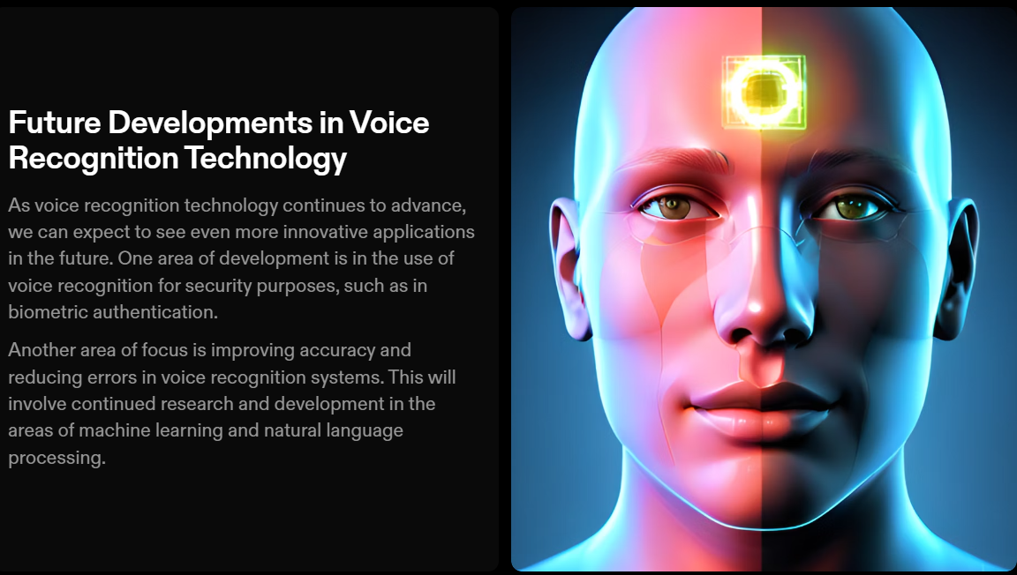
School of Computing Science and Engineering
Program Name :
B.Tech CSE

Slide 8
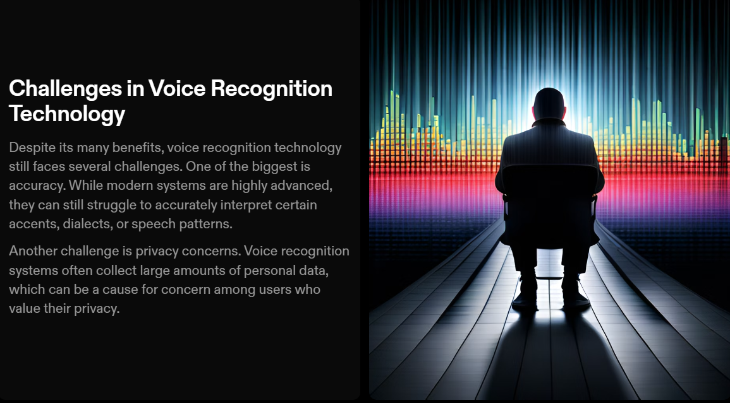
School of Computing Science and Engineering
Program Name :
B.Tech CSE

Slide 9
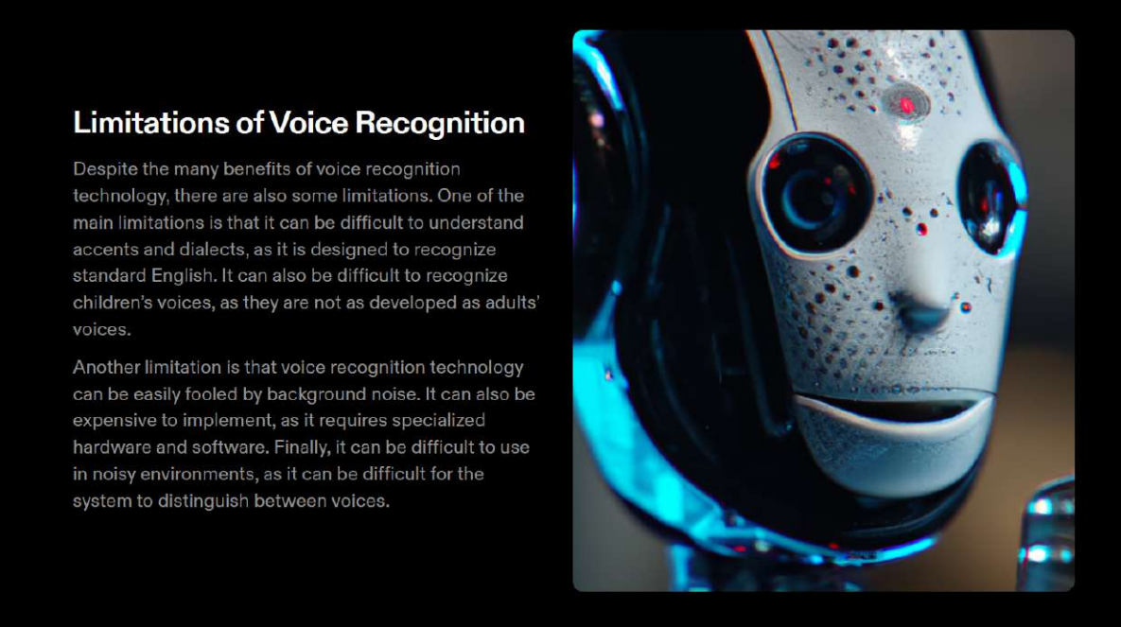
School of Computing Science and Engineering
Program Name :
B.Tech CSE

Slide 10
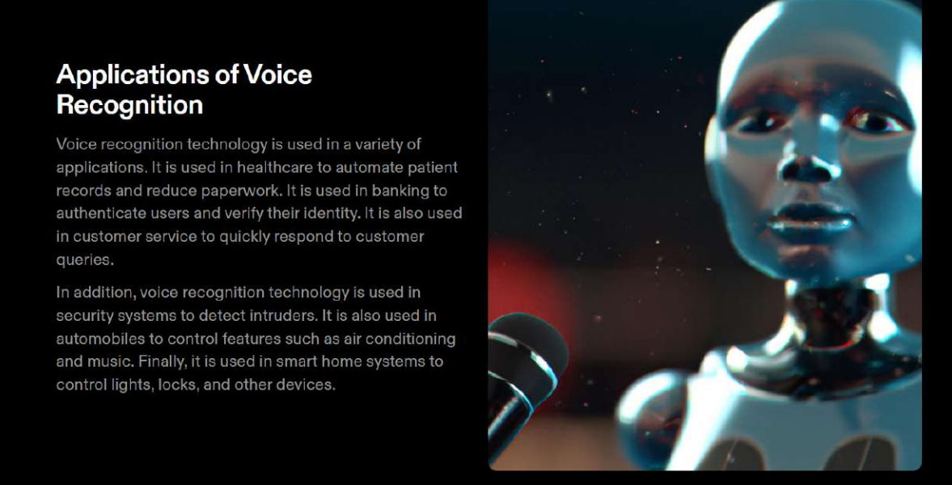
School of Computing Science and Engineering
Program Name :
B.Tech CSE

Slide 11
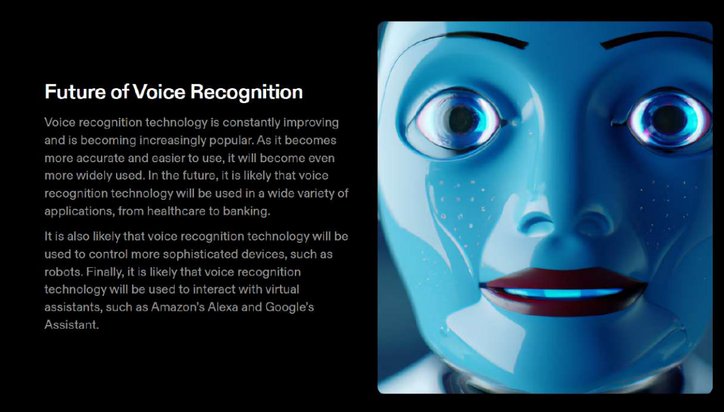
School of Computing Science and Engineering
Program Name :
B.Tech CSE

Slide 12
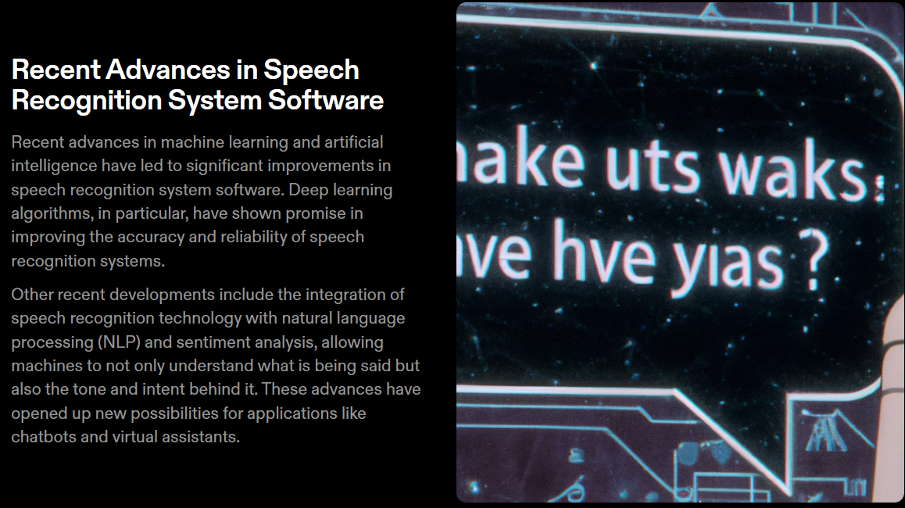
School of Computing Science and Engineering
Program Name :
B.Tech CSE

Slide 13
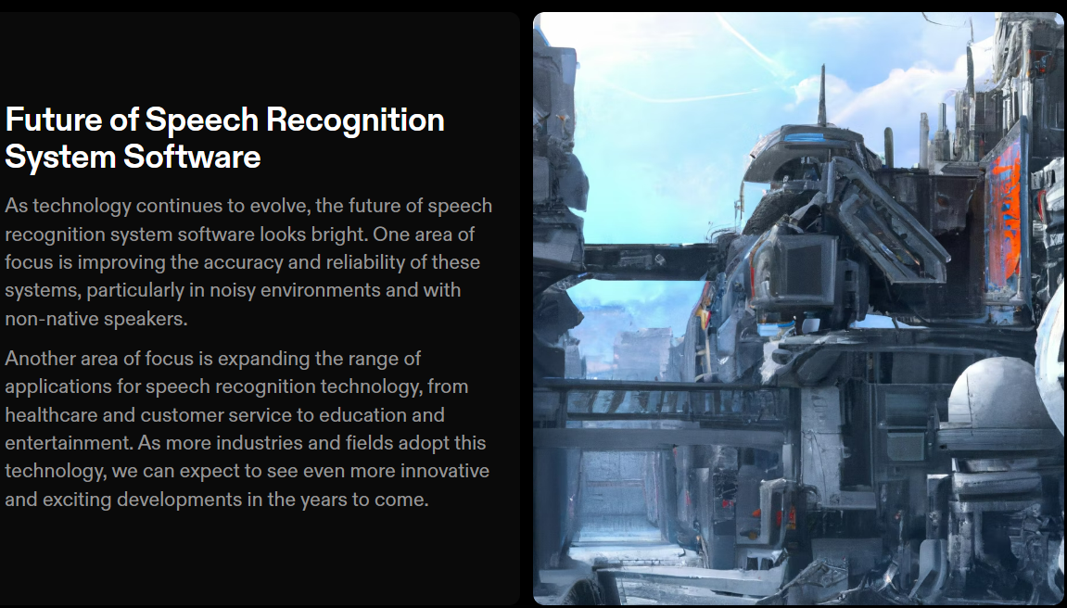
School of Computing Science and Engineering
Program Name :
B.Tech CSE

Slide 14
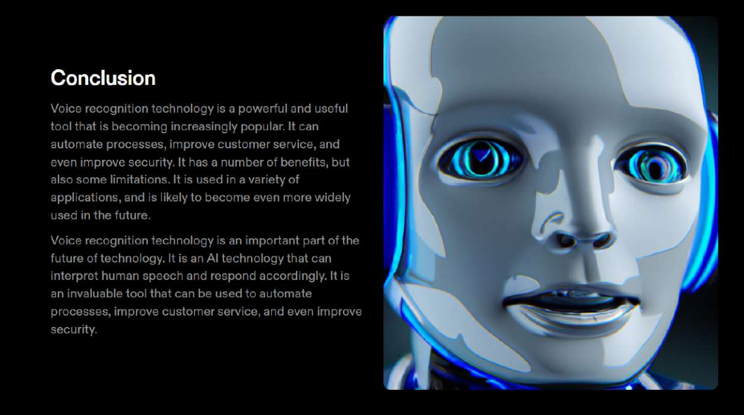
School of Computing Science and Engineering
Program Name :
B.Tech CSE

Slide 15
School of Computing Science and Engineering
THANK YOU
Program Name :
B.Tech CSE

